Slide 1
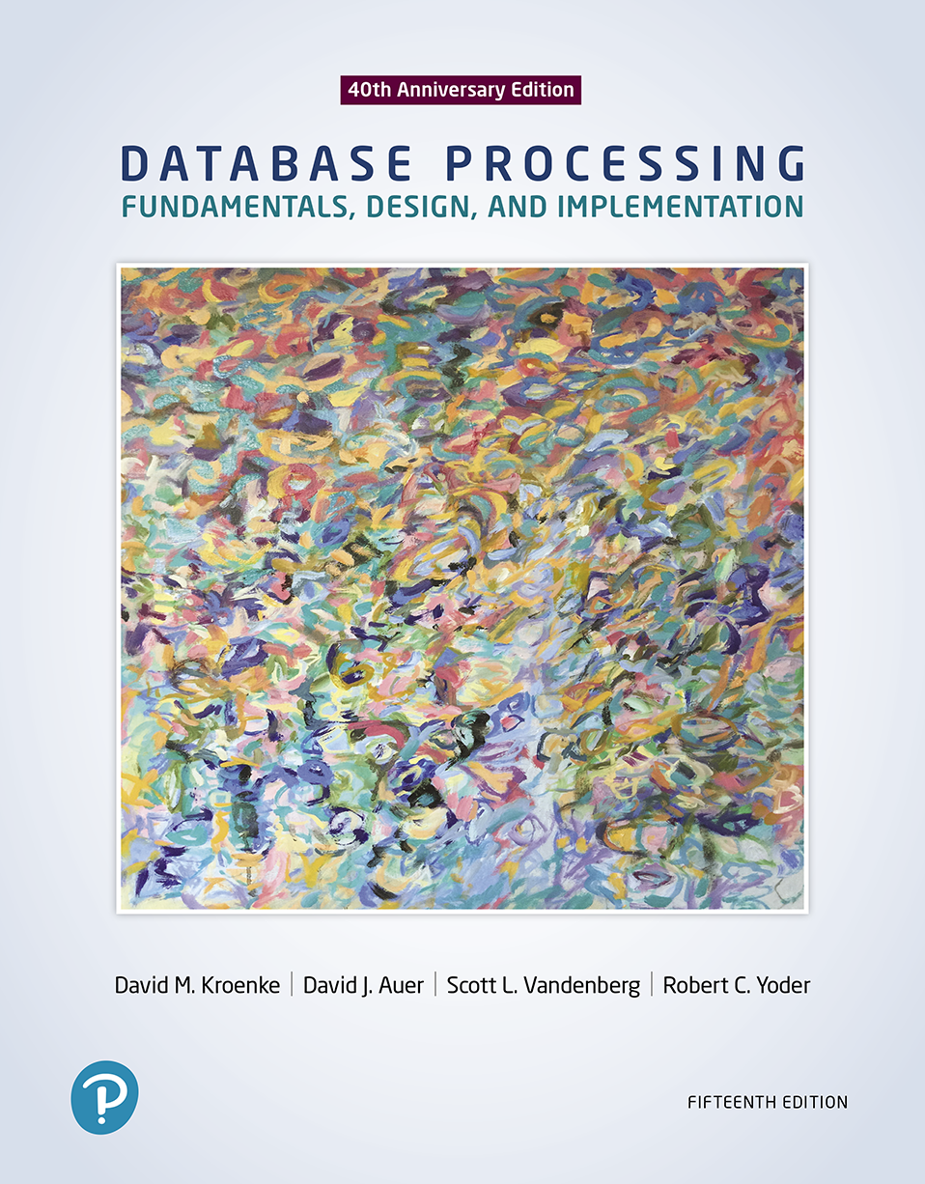
Database Processing: Fundamentals, Design, and Implementation
15th Edition
Week #13
Embedded Persistent Modules

Slide 2
SQL/Persistent Stored Modules (SQL/PSM)
SQL/Persistent Stored Modules (SQL/PSM) are used for embedding procedural programming functionality into SQL
Using Functions:
A function is a stored program that is executed by the user
Using Triggers:
A trigger is a stored program that is executed by the DBMS whenever a specified event occurs.
Using Procedures:
A stored procedure is a program that is stored within the database and is compiled when used.

Slide 3
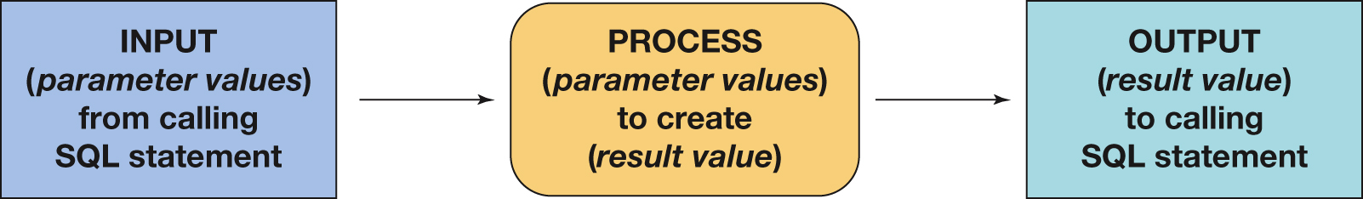
User-Defined Functions Logical Process Flow
A user-defined function (stored function) is a stored set of SQL statements that:
is called by name from another SQL statement
may have input parameters passed to it by the calling SQL statement
returns an output value to the SQL statement that called the function

Slide 4
User Defined Function to Concatenate LastName and FirstName
CREATE FUNCTION dbo.NameConcatenation
-- These are the input parameters
(
@LastName CHAR(25),
@FirstName CHAR(25)
)
RETURNS VARCHAR(60)
AS
BEGIN
-- This is the variable that will hold the value to be returned
DECLARE @FullName VARCHAR(60);
-- SQL statements to concatenate the names in the proper order
SELECT @FullName = RTRIM(@LastName)+ ', ' + RTRIM(@FirstName);
-- Return the concatenate name RETURN @FullName;
END;

Slide 5
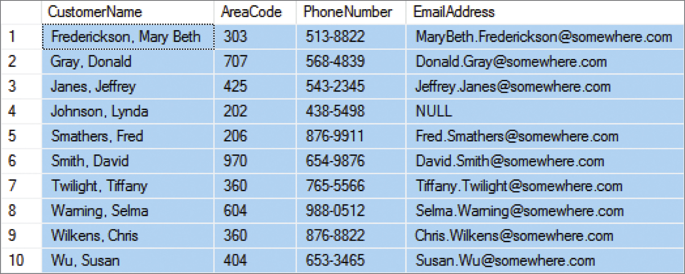
Using the NameConcatenation Function
SELECT dbo.NameConcatenation (LastName, FirstName) AS CustomerName, AreaCode, PhoneNumber, EmailAddress
FROM CUSTOMER
ORDER BY CustomerName;

Slide 6
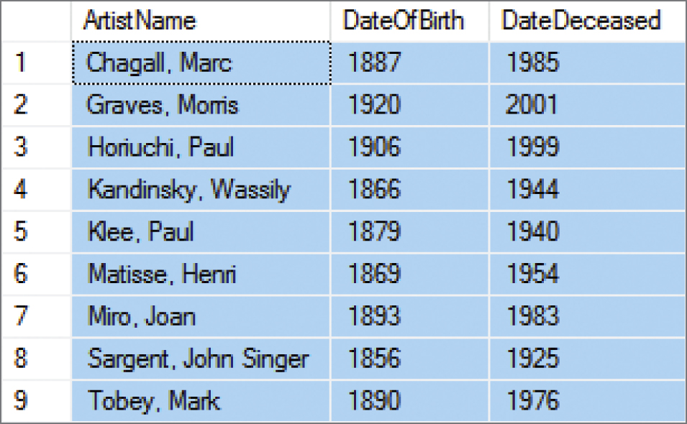
The Advantage of Having a User-Defined Function
We can use it whenever it is appropriate!
SELECT dbo.NameConcatenation (LastName, FirstName) AS ArtistName, DateofBirth, DateDeceased
FROM ARTIST
ORDER BY ArtistName;

Slide 7
Uses for SQL Triggers
When a trigger is fired, the DBMS supplies:
Old and new values for the update
New values for inserts
Old values for deletions
The way the values are supplied depends on the DBMS product.
Uses of SQL Triggers
Provide default values.
Enforce data constraints.
Update views.
Perform referential integrity actions.

Slide 8
Using SQL Triggers
Three trigger types: BEFORE, INSTEAD OF, and AFTER
Each type can be declared for Insert, Update, and Delete
Resulting in a total of nine trigger types
Different database engines support different trigger types:
Oracle supports all nine trigger types.
SQL Server supports six trigger types (INSTEAD OF and AFTER).
MySQL supports six trigger types (BEFORE and AFTER).

Slide 9
Using Stored Procedures
A stored procedure is a program that is stored within the database and is compiled when used.
Stored procedures can receive input parameters and they can return results
Stored procedures can be called from:
Programs written in standard languages, e.g., Java, C#
Scripting languages, e.g., JavaScript, VBScript
SQL command prompt, e.g., SQL Plus

Slide 10
Figure 7-31 Advantages of Stored Procedures
Advantages of Stored Procedures
Greater security.
Decreased network traffic.
SQL can be optimized.
Code sharing.
Less work.
Standardized processing.
Specialization among developers.

Slide 11
Figure 7-30 Triggers Versus Stored Procedures
Trigger
Module of code that is called by the DBMS when INSERT, UPDATE, or DELETE commands are issued.
Assigned to a table or view.
Depending on the DBMS, may have more than one trigger per table or view.
Triggers may issue INSERT, UPDATE, and DELETE commands and thereby may cause the invocation of other triggers.
Stored Procedures
Module of code that is called by a user or database administrator.
Assigned to a database, but not to a table or a view.
Can issue INSERT, UPDATE, DELETE, and MERGE commands.
Used for repetitive administration tasks or as part of an application.

Slide 12
Figure 7-33 Comparison of User-Defined Functions, Triggers, and Stored Procedures
 | User-Defined Functions | Triggers | Stored Procedures
Can accept parameters | Yes | No | Yes
Can return a result value or values | Yes | No | Yes
Can be used in SELECT statements | Yes | No | No
Can use SELECT statements | Yes | Yes | Yes
Can use INSERT statements | No | Yes | Yes
Can use UPDATE statements | No | Yes | Yes
Can use DELETE statements | No | Yes | Yes
Can call a User-Defined Function | Yes | Yes | Yes
Can invoke a Trigger | No | Yes Indirectly via INSERT, UPDATE, or DELETE) | Yes (Indirectly via INSERT, UPDATE, or DELETE)
Can invoke a Stored Procedure | No | Yes | Yes
Is stored as a database-wide object | Yes | No | Yes
Is stored as a table-specific object | No | Yes | No

Slide 13
Database Processing Fundamentals, Design, and Implementation (15th Edition)
End of Presentation:
Week #13

